Slide 1








Machine
Learning
Project

Slide 2
Which models did we use? What we did, we tried to delete little interests column. Normalization(PowerTransformer(method='yeo-johnson', standardize=True)). Let us briefly explain how the winning model works.
We used the scrum method slack github made daily google Meet. We are working on article improvements.
When estimating demo credit score, credit score I may not be determined more than once. 10 scipt can be estimated randomly

Slide 3



Team members
march
Credit
score Machine learning Project
Rumeysa yakar
Rama
Nahawandi
Juan David Obregon Ruiz
Sefa
sahan
Irfan
akgul

Slide 4
Project Aim
Credit
score Machine learning Project
Using historical financial information of bank customers
predict credit scores for bank customers using machine learning techniques
help banks accurately measure the credit risks of their customers.
Notes:
"Hello everyone, my name is [Name] and we are here to present our project. We're using machine learning techniques to predict credit scores for bank customers, by using their historical financial information. By doing so, we aim to provide a solution that will enable banks to make more informed lending decisions, while accurately measuring credit risk. Our goal is to build a credit score prediction model with bank customer data, which will ultimately help banks assess the creditworthiness of their customers with greater accuracy."

Slide 5
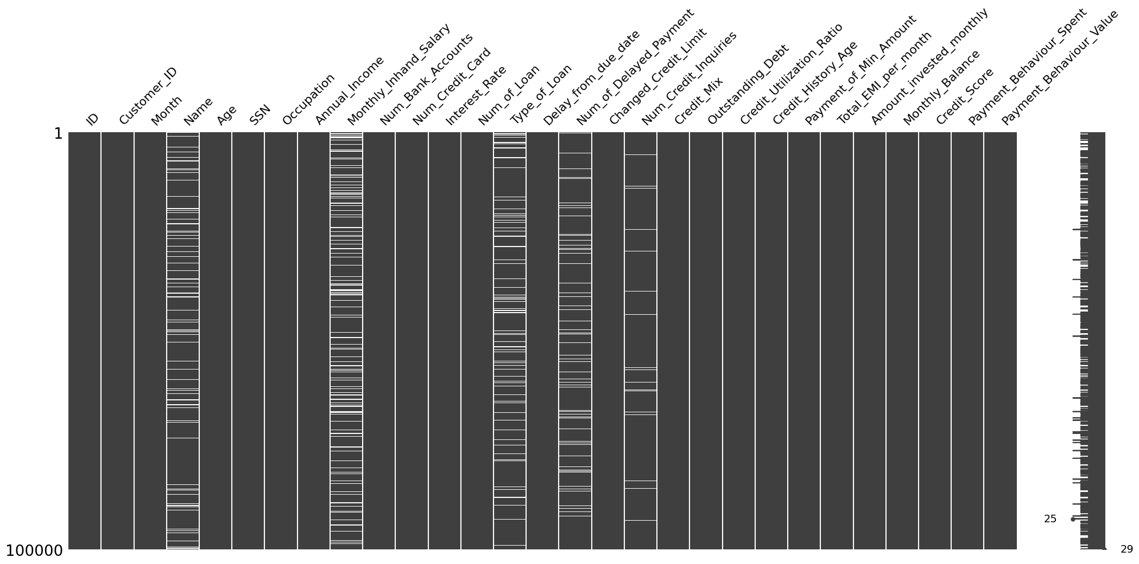
Data management
Credit
score Machine learning Project
Notes:
As you can see in the chart, we have some missing values, as well as outliers, in our dataset. Additionally, we found that some columns had redundant information, such as 'Monthly Salary' and 'Annual Salary', which required us to perform further data cleaning."

Slide 6
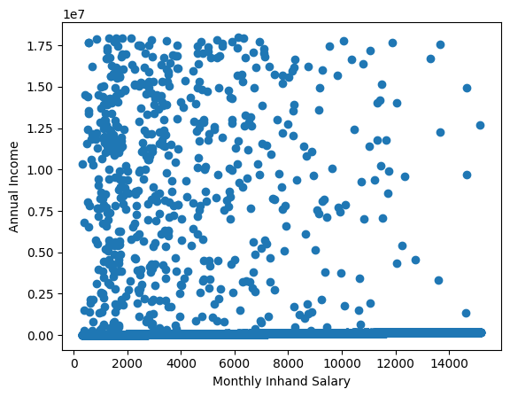
Data management
Credit
score Machine learning Project
Notes:
we used machine learning linear regression method to fill some missing values in our dataset.
The annual salary and monthly salary columns should have the same values, but there is no correlation between the two column as you see in this chart.
In the annual salary column, there are some outliers,
There are some millionaires who are looking for education credit in our dataset.
At the same time In the monthly salary column, there are also some missing values.

Slide 7
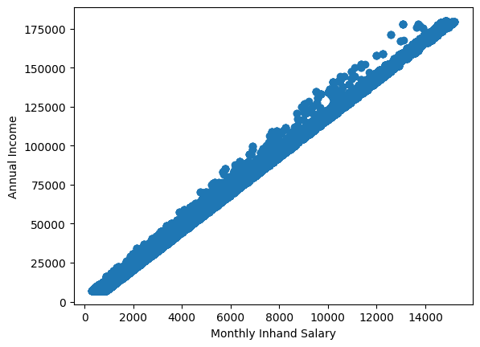
Data management
Credit
score Machine learning Project
Notes:
However, there is a correlation between the two columns under 180k annual salary.
We used linear regression ML method to fill these NaN values, which resulted in 99% accuracy.

Slide 8
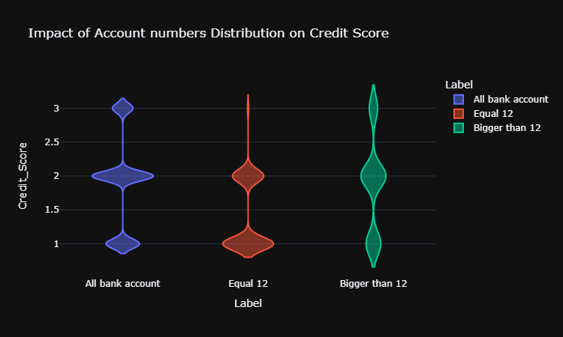
Data management
Credit
score Machine learning Project
Notes:
In this chart you can see the distribution of customer bank account numbers and customer credit scores.
This shows us that if a customer has more accounts, the credit score decreases.
Some outlier for customer bank account numbers are also present, and their distribution looks like the general distribution.
Therefore, we changed these outliers with median values instead of the mean, as the outliers are too big and would affect the mean.
We also changed missing values with median values in other columns for the same reason.
Finally, some columns had dirty data with '_' characters, which we properly cleaned up.

Slide 9
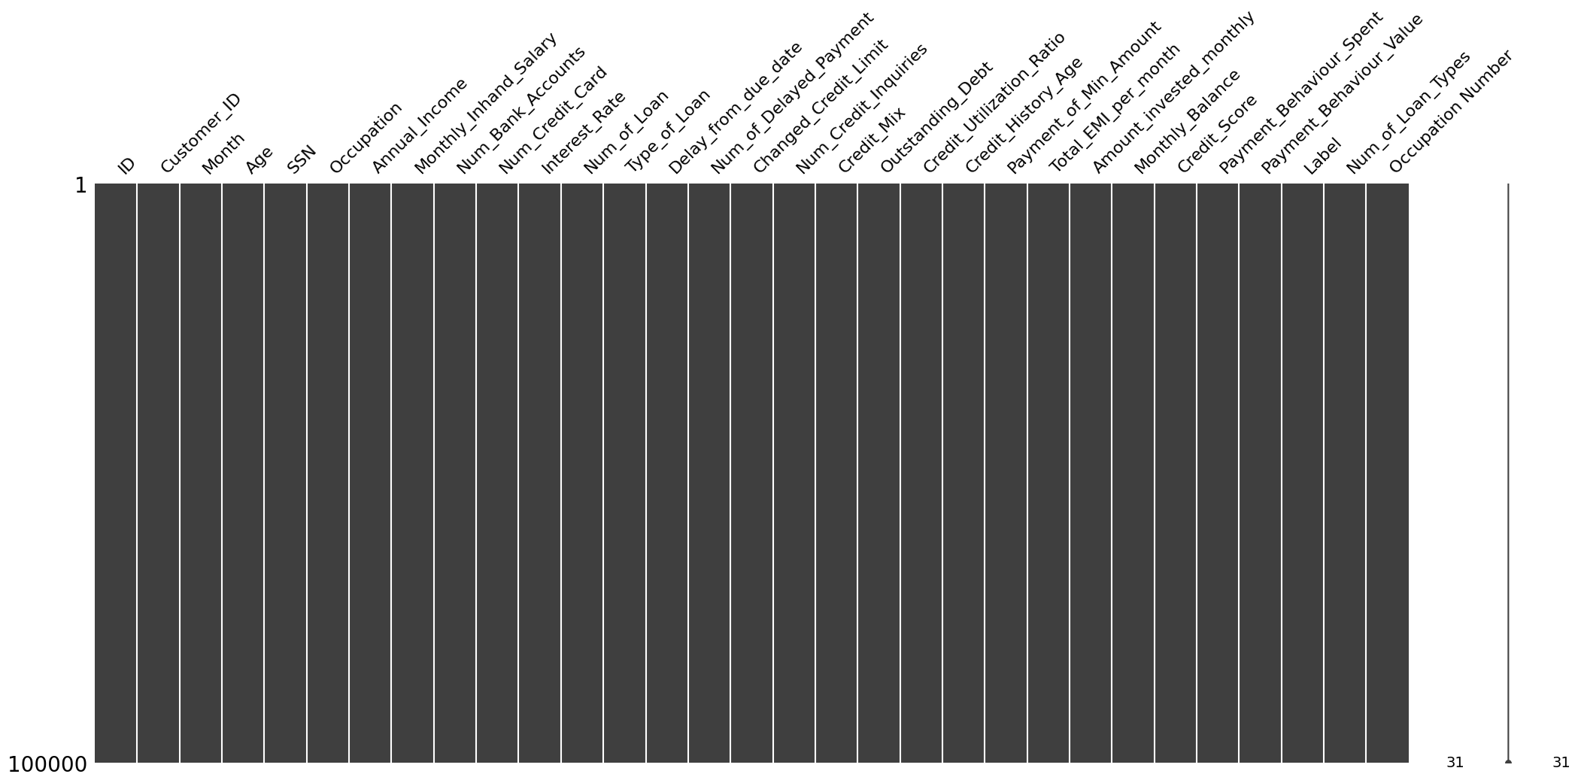
Data management
Credit
score Machine learning Project
Notes:
After clean our dataset we have no missing values and neither outliers.

Slide 10
Data Analysis
Credit
score Machine learning Project

Slide 11
Machine learning
Credit
score Machine learning Project

Slide 12
teamwork
Credit
score Machine learning Project

Slide 13
Demo Time
Credit
score Machine learning Project

Slide 14
results
Credit
score Machine learning Project

